Slide 1
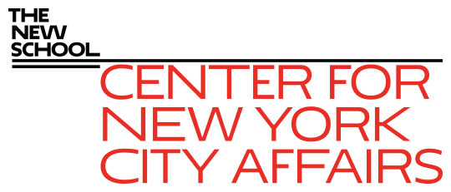
How Does NYC Get Its Jobs Back? James A. Parrott, PhD Center for New York City Affairs at The New School JamesParrott@newschool.edu www.centernyc.org Harvard Business School Club of NY June 17, 2021 Funding support provided by the Robin Hood Foundation, New York City Workforce Development Fund, New York Community Trust, JPMorgan Chase Foundation, 21st Century ILGWU Heritage Fund, and Consortium for Worker Education
James A. Parrott, PhD
Director of Economic and Fiscal Policies
Center for New York City Affairs
New School University
JamesParrott@newschool.edu

Slide 2
Overview
How is the Covid-19 economic dislocation different?
Which workers were affected?
How has the pandemic re-shaped the city’s economy and its jobs?
What has to happen for the NYC job market to recover?

Slide 3
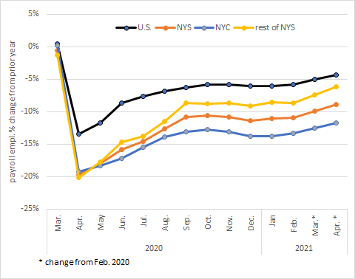
As of Apr., NYC jobs were 11.8% below Feb. 2020; 2.7 times the national 4.4% drop

Slide 4
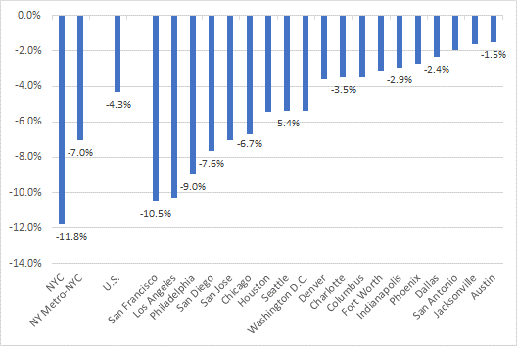
NYC job losses greatest among 20 largest U.S. cities Feb. 2020-Apr. 2021

Slide 5
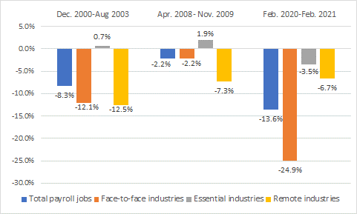
Pandemic’s distinctive pattern of NYC job losses

Slide 6
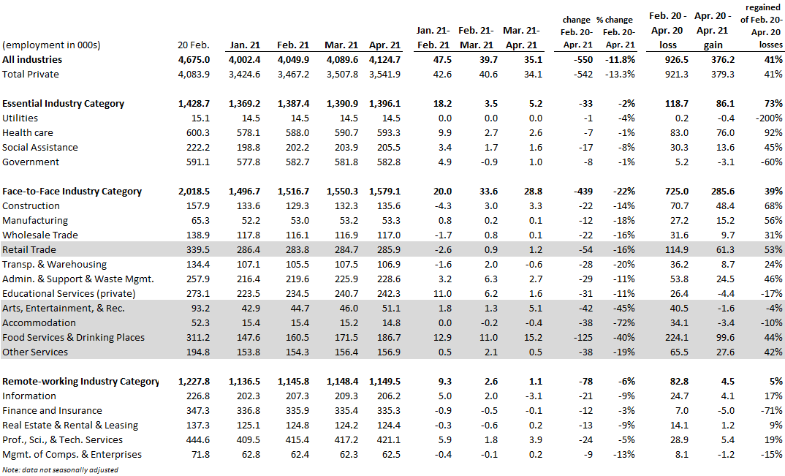
As of April, NYC still down 550,000 payroll jobs since Feb. 2020; only 41% of lost jobs have been regained (vs. 70% in rest of the U.S.)

Slide 7
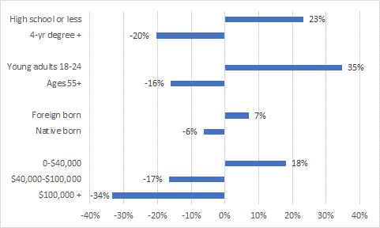
Workers of color are 75% of those losing jobs; chart below shows likelihood of losing job compared to the average

Slide 8
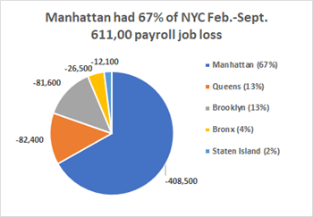

Slide 9
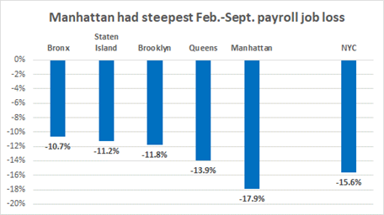

Slide 10
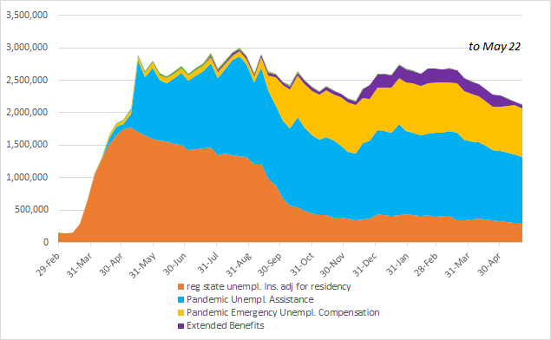
As of late-May, NYS continuing unemployment insurance claims were about 2.1 million, down by 600,000 since mid-January inflection; in 3 months, it will be about 300,000

Slide 11
Are unemployment benefits the reason some employers are having a hard time recruiting workers?
No simple answers in an unsettled job market
Record quit rates as well as openings, esp. in restaurants
Lack of affordable child care a huge challenge
Lingering concerns about unvaccinated persons
NYS’s partial unemployment system complicates assessing effects on benefits of PT work
Workers should be able to rethink their return-to-work and career options—the economy will be benefit in the long run

Slide 12
Astoria survey we did with the Consortium for Worker Education pointed up several challenges NYC workers face post-Covid
One-third of respondents were furloughed or laid off; another 35% lost hours and pay
More than ¾ of < $50k households lost jobs or pay
Freelancers had even higher rates of displacement than payroll workers (85% vs. 58%)
Only 38% of dislocated returned to work (only 1/3 full-time, 2/3 part-time)
Only 42% of dislocated expected to return to work with the same employer; 20% expected to have to find work in a new occupation or industry.

Slide 13
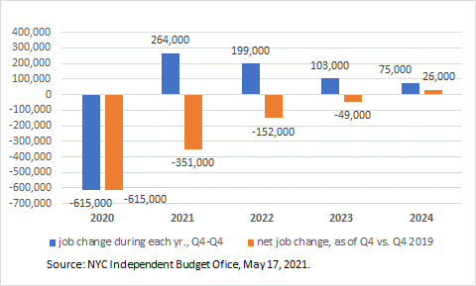
NYC Independent Budget Office projects Covid-19 jobs deficit will last until late 2024 (w/o accounting for changing mix)

Slide 14
Policy priorities—build back better
Permanent job losses and rapidly shifting job demands mean re-deployment & re-training of tens of thousands of NYC workers.
NYC should start using American Rescue Plan Act funds now to re-deploy 150,000-200,000 workers or we risk losing strong 2013-19 economic gains.
Proposed American Jobs Plan w/ both physical and social infrastructure components will help, but may not be sufficient.
City did nothing to respond to early 1990s recession (or post-2008/09 Great Recession—it took years before pre-crisis job levels returned. Consequence was several years of double-digit unemployment for Black and Latinx workers.

Slide 15
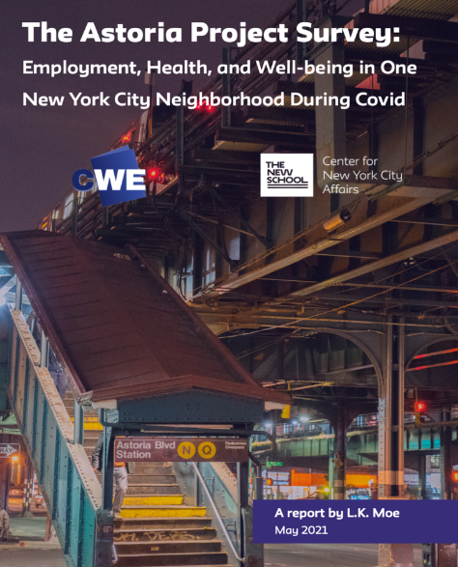
CNYCA’s Covid-19 Economic Recovery Project
http://www.centernyc.org/covid19-economic-impact for all reports, updates, news coverage, presentations
Bi-weekly Economic Updates in NYC Employment and Training Coalition’s Workforce Weekly
Recent Astoria report: http://www.centernyc.org/reports-briefs/2021/6/2/the-astoria-project-employment-health-and-well-being-in-one-new-york-city-neighborhood-during-covid

Slide 16
Thank you. James Parrott Center for New York City Affairs The New School ParrottJ@newschool.edu
www.CenterNYC.org

