Slide 1
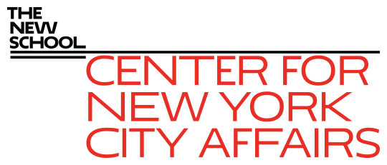
NYC Covid-19 economic recovery project James A. Parrott Center for New York City Affairs at The New School JamesParrott@newschool.edu www.centernyc.org New York City Central Labor Council Executive Board September 28, 2020 Funding support provided by The Consortium for Worker Education and 21st Century ILGWU Heritage Fund
James A. Parrott, PhD
Director of Economic and Fiscal Policies
Center for New York City Affairs
New School University
JamesParrott@newschool.edu

Slide 2
Economic Update: More precarious NYC economy than any time since the 1970s economic/fiscal crisis
Covid-19 economy job losses not like a recession. Lop-sided impact hitting hardest at low-wage services.
While 235,000 NYC payroll jobs have returned since Apr., we’re still down 680,000 (15% of Feb.)
Also down 500,000-600,000 self-employed & indep. cont. jobs.
Altogether, 1.2-1.3 million NYC residents (1/3 of total workforce) receiving unemploy. benefits.

Slide 3
In addition to enormous job losses, broader economic risks to NYC
Covid economy not only hitting certain industries hard, but jeopardizing survival of thousands of businesses on an unprecedented scale.
Posing severe challenge to how NYC functions—threatens arts, tourism, Manhattan office-using econ., const. & NYC tax base.
We risk losing many of the gains achieved in recent years with low unemployment, strong job growth, and wage gains.

Slide 4
The Covid-19 crisis economy
3 groups of industries
Essential: health care, food, public safety and services
Face-to-face: restaurants, retail, arts, transportation, construction, local services
Remote: finance and real estate; profession services; higher education; information
=> A new strain of inequality hitting hardest at low-wage workers, many of color.

Slide 5
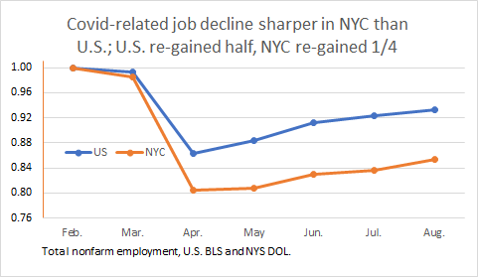

Slide 6
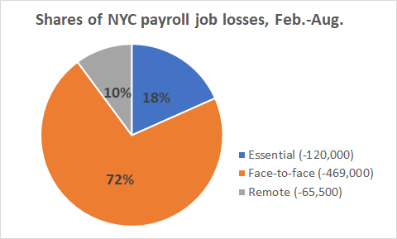
Note: self-employed and independent contractors have lost 500,000 + jobs
not included in the payroll job numbers.

Slide 7
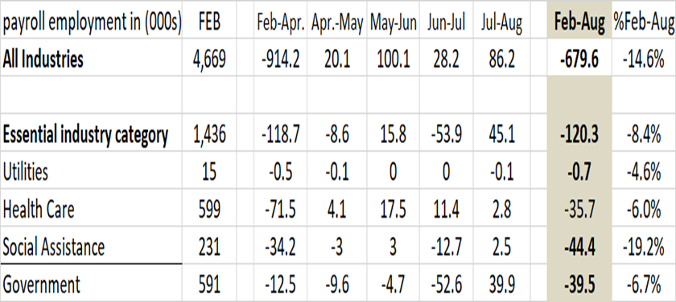
3 charts showing NYC monthly payroll jobs change, Feb.-Aug. 2020

Slide 8
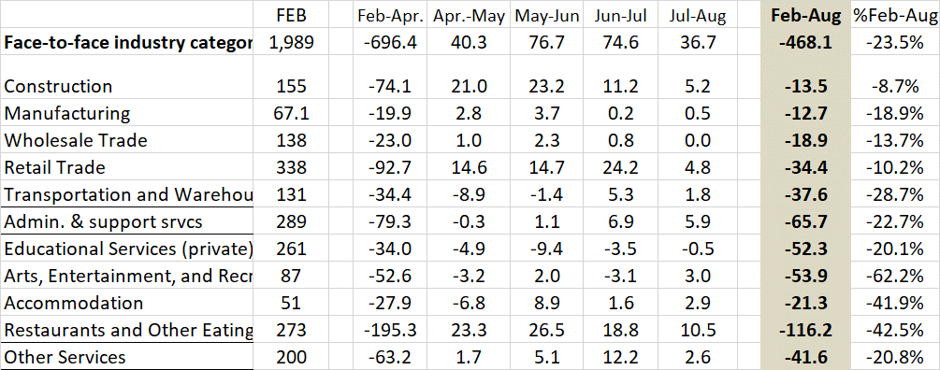

Slide 10
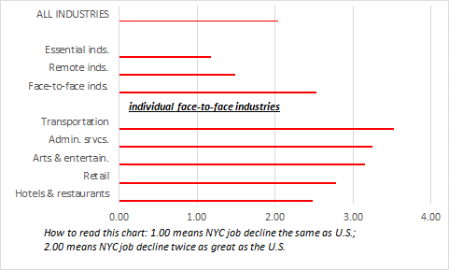
NYC industries with greatest job losses vs. the U.S. are all face-to-face industries, Feb.-Jul. 2020

Slide 11
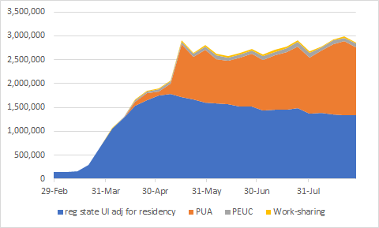
NYS continuing weekly UI claims to Aug 29; NYC accounts for 54% of statewide total.

Slide 12
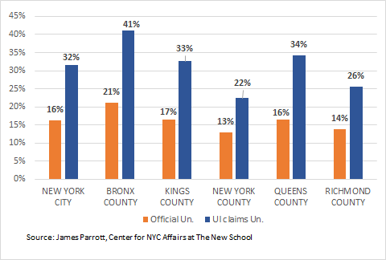
Official NYC unemployment rate vs. UI claims as % of Feb. labor force, Aug. 2020

Slide 13
CNYCA Covid-19 Economic Recovery Project
Analyze nature and magnitude of job displacements to inform NYC & NYS policy (UI , workers comp, tax & budget issues)
Through CWE and CBO and Union partners, worker perspectives informing our analysis
Inform workforce development organizations regarding return to work, health & safety, training needs, and demand-side policies
CWE Astoria project to spotlight impact and potential in working/middle class community

Slide 14
The road from here?
No alternative to massive Federal economic support:
For workers and families
To keep small businesses alive
Need state policy changes to improve social & worker safety net.
To maintain public services and re-build our health care system
Ultimately, need Federal investments in mass transit, infrastructure and the caring economy.
Also need policies to ensure broadly shared prosperity, incl. expanded health care, enable workers to organize, rein in big tech, and fair taxation.

